Slide 1

Exploring Dengvaxia® Efficacy and Safety
October 19, 2017

Slide 2
Inferences and predictions
The confounding relationship between Infection History and Age
Medical records
Baseline PRNT records
The effect of Age on the odds ratio of VCD.
Selecting subgroups of subjects by Age, and predicting their efficacy:
Vaccine efficacy
Hospitalization incidence ratio
Notes:
At our last meeting we spoke about additional research items of interest
We have three exciting inferences to share with you today
The first is regarding whether or not there is a confounding relationship between Infection History and Age
We know that you have been trying to tease out if age is a proxy for infection history or a factor in and of itself. We have some inferences from our models that help shed some light on this
The second is… we know that determining the cutoff point for age is something that you’re interested in workign with REFS for… we are presenting here that REFs and GNS can help with this…
The third is can Refs stratify subjects into subgroups and then calculate efficacy for those subgroups. We’ve done this with age.

Slide 3
The Data, Structural Priors, and Model
Notes:
Change to ’construction and performance’?

Slide 4
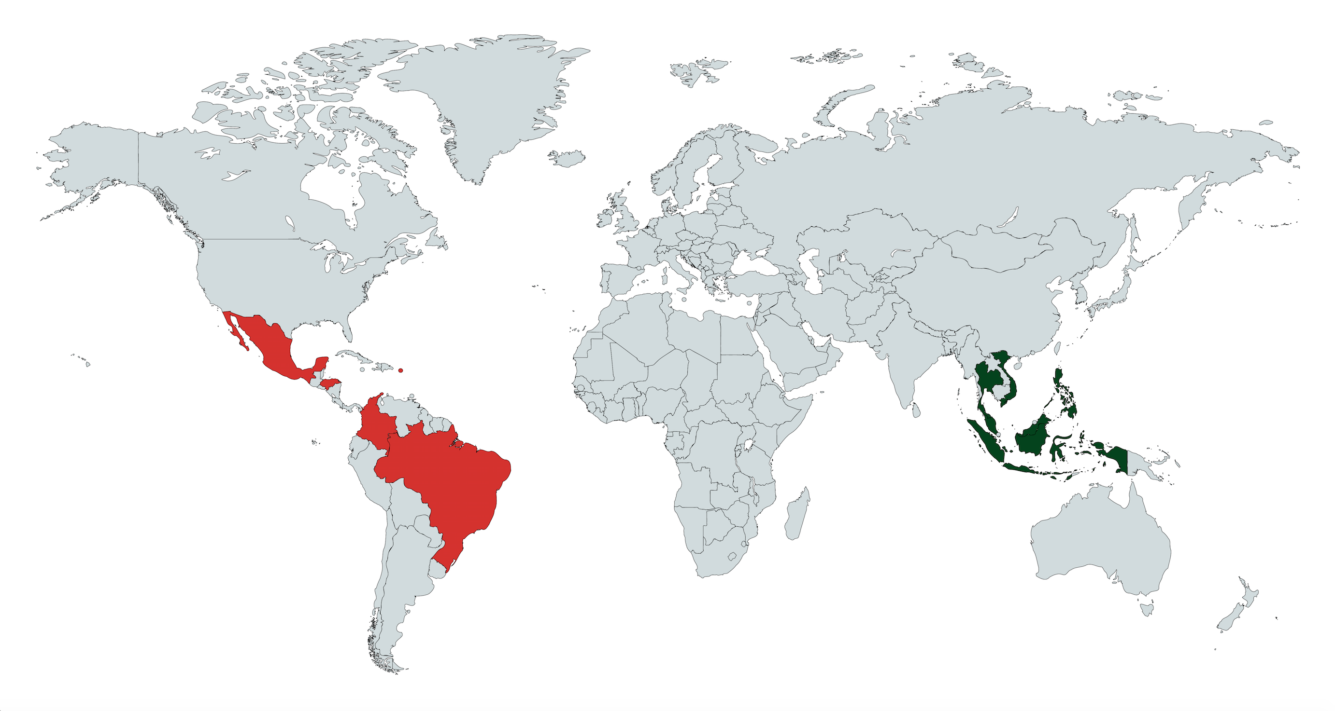
What can be learned from a single Phase III study?
CYD14
IDN, MYS, PHL, THA, VNM
N = 10,275
2011-2016
CYD 15
Notes:
Note that this is a proof of concept study: one trial, given the correct data, can be used to predict results of a future study, even in a different region.
We used CYD14 because the data collected was similar to the data we used to validate (CDY15).
The question of ‘could we use CYD23 to predict 14/15’ is a separate study that would be dependent on the data available in CYD23 and the questions being asked. HOWEVER, we demonstrate here that predicting one trial with another is possible given the right data.

Slide 5
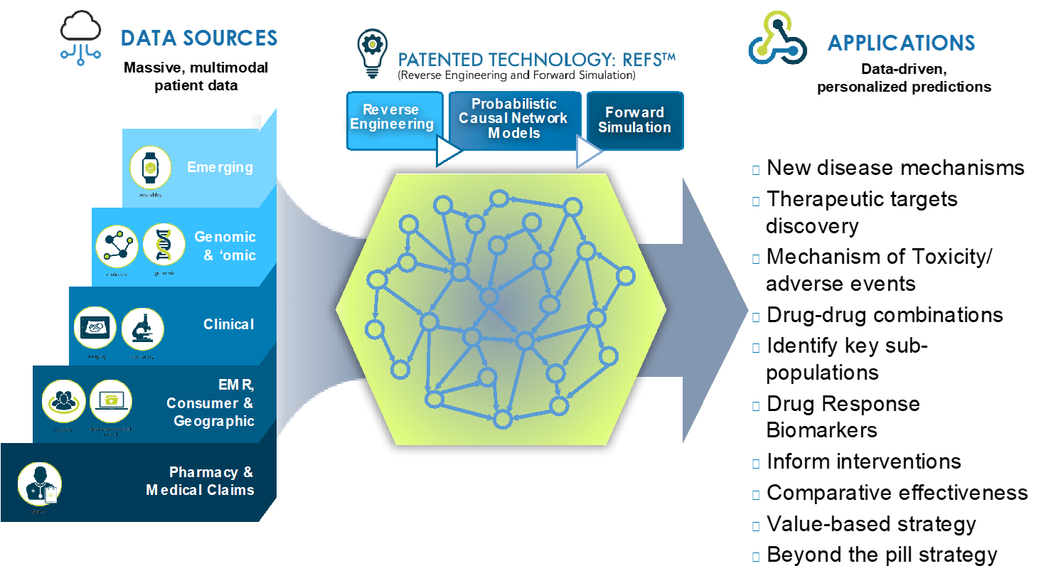

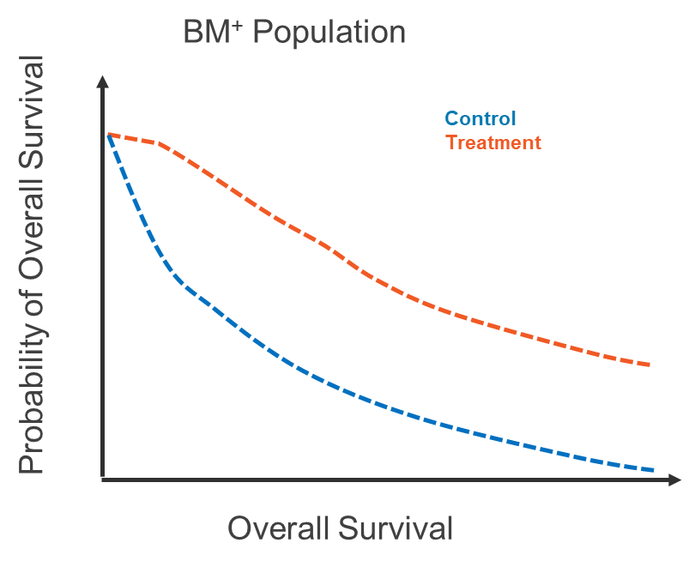

Model construction for baseline CYD14 data
Subset of Clinical Data: CYD14
BM⁺ Population
Control
Treatment
ΔHR
Notes:
Make it clear that we are presenting a model that we built for this occasion – one that we have not presented before.
Add a slide detailing what clinical data/ subset of subjects we used.
Specify that we used baseline info only in this model
What VCD timepoints were used? Are all instances of VCD throughout the trial treated as one timepoint?
Caveats:
Hospitalization for VCD was not included in this data-set.
Infection History is derived from Medical Records

Slide 6
Model constraints
Input-only
Baseline
Country
Treatment
Input-output
Age
Medical History
Baseline PRNT
Weather
Google Trends
Output-only
Active phase
VCD
Notes:
This is a simple proof-of-concept model with one outcome of interest. Hospitalization was excluded for simplicity’s sake. Future analysis could include hospitalization as an outcome.

Slide 7
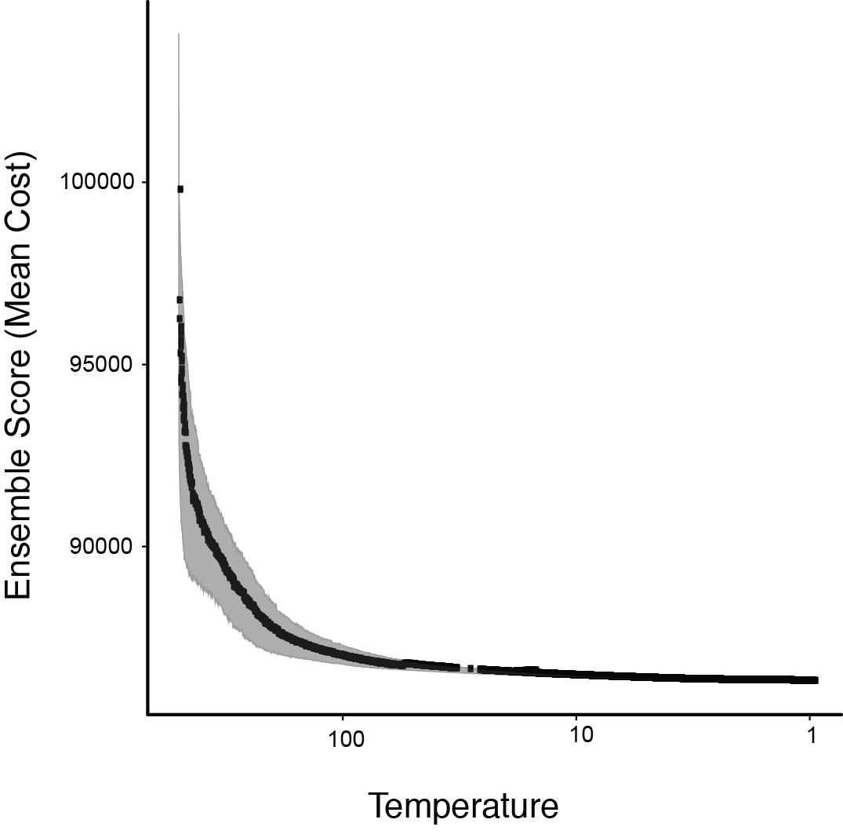
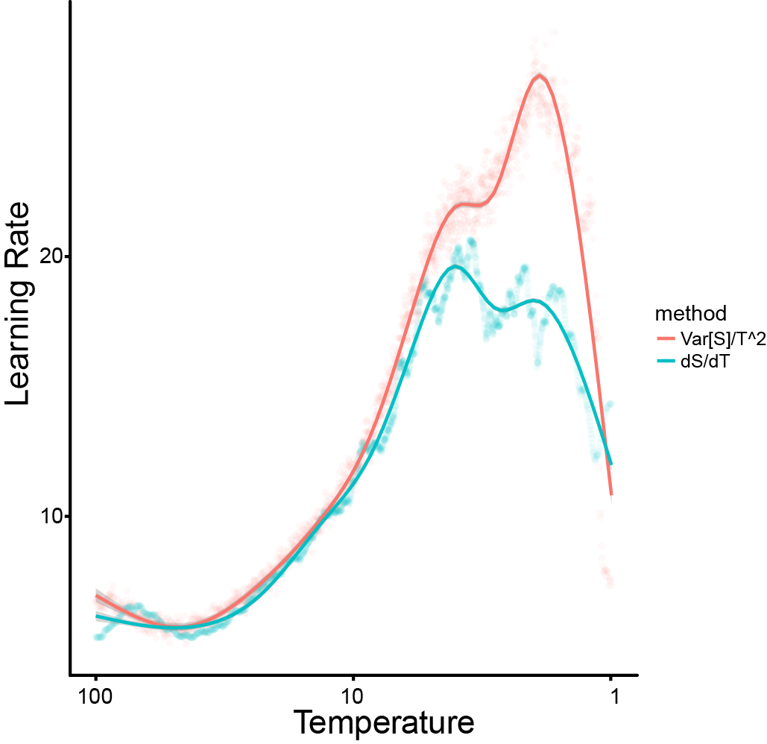
Convergence as a test for model bias
The objective of a REFS™ model is to achieve an unbiased probability distribution.
An un-converged model indicates a biased distribution.
Markov Chain Monte Carlo and Simulated Annealing algorithms sample the distribution of models given the data and prior modeling constraints.
The ensemble of networks is a set of samples from this posterior distribution.
Notes:
Make sure the axes are headed in the same direction

Slide 8
Inferences and Predictions
Prior history of infection confounds the Age/Vaccine Efficacy relationship

Slide 9
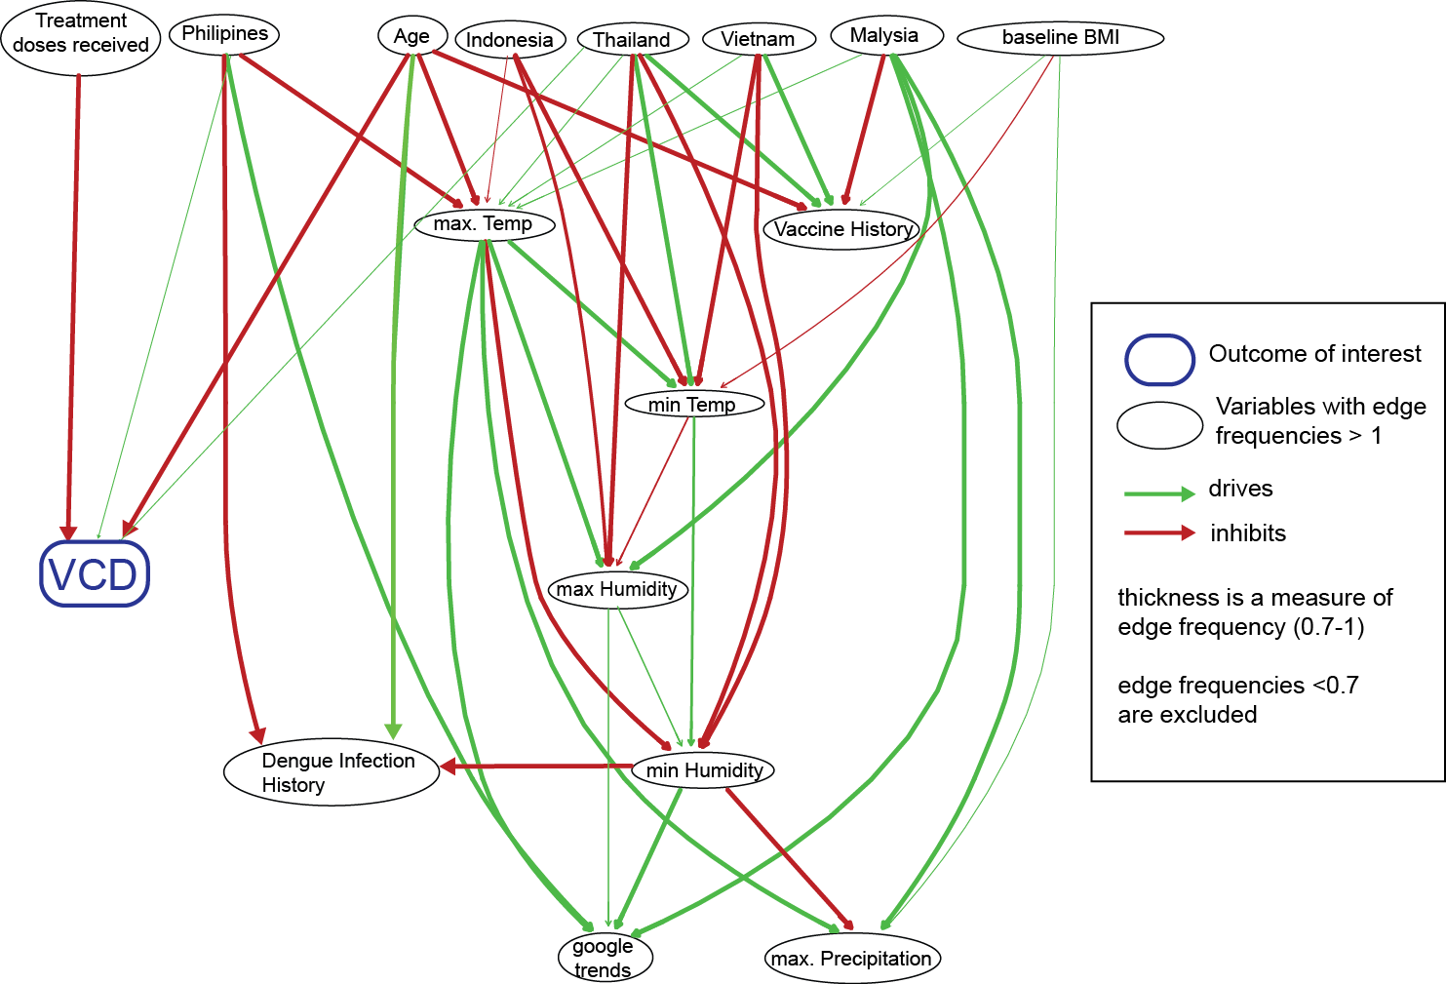
Age and Vaccine affect VCD outcomes directly
Age and Treatment (with vaccine) inhibit contraction of dengue virus.
No interaction found between Infection History and VCD.
Interpretation note: Not all edges in a causal model are biological predictors. For example, Age is a predictor of max. Temp here because both age and temperature are related to trial country. Thus, we can predict max temperature based on the age of the subject.
Notes:
This is direct edges, there are no hidden factors between, for example, the Philipines and VCD
Cutoff is .7
Thinner lines == weaker edge
Age and Treatment inhibit dengue virus contraction
No interaction found between Infection History and VCD

Slide 10
Baseline PRNT confounds the relationship between Age and VCD
Self-reported dengue infection history prior to trial start confound the relationship between Age and VCD with 0.003 structural probability.
Baseline PRNT for Serotypes 1 and 3 confound the relationship between Age and VCD with 0.947 and 0.456 structural probability, respectively.
This effect was not present for serotypes 2 and 4.
Infection
History
PRNT
S-1, 3
Treatment
Age
VCD
This suggests that older children with negative PRNT at baseline may be more susceptible to VCD than younger children with a positive PRNT for serotype 1 or 3.
Notes:
Infection History Confounds the Relationship Between Age and VCD

Slide 11
Inferences and Predictions
Efficacy can be predicted across different age cut-points

Slide 12
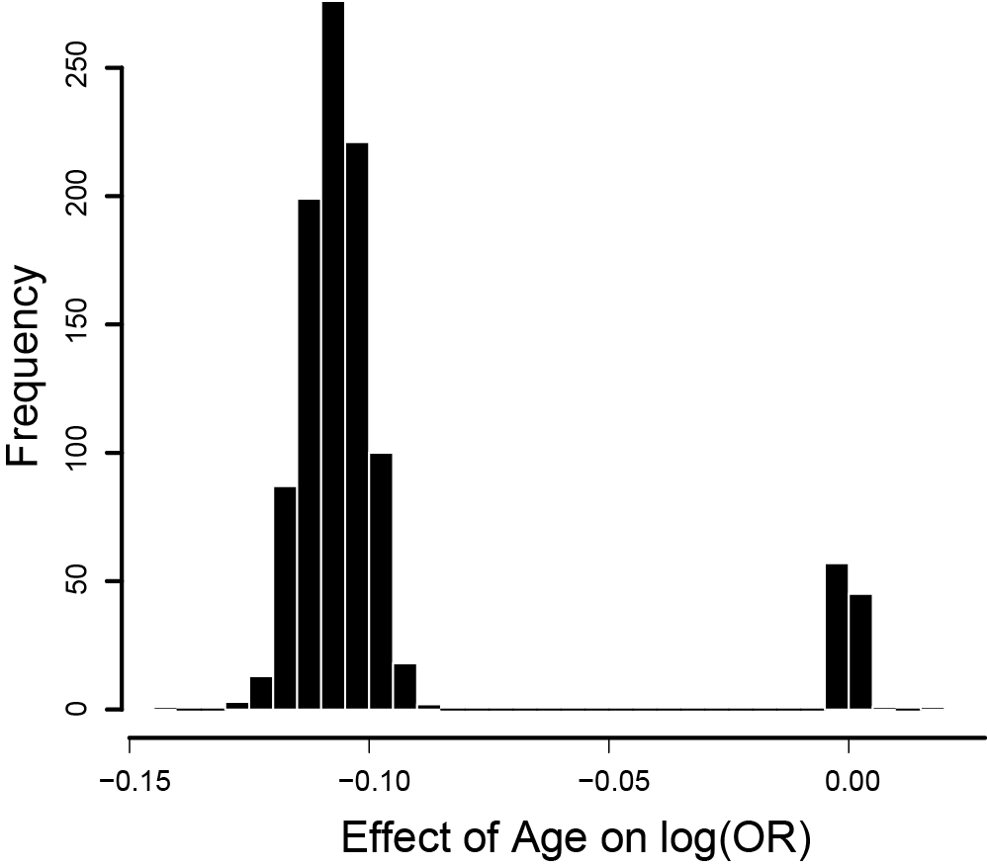
Age has an effect on dengue infection Odds Ratio (OR)
Example:
An increase in age from 8 to 9 decreases a subject’s odds of getting Dengue from 0.449 to 0.407
Histogram is derived from (n = 1024) network samples from P(N | Data).

Slide 13
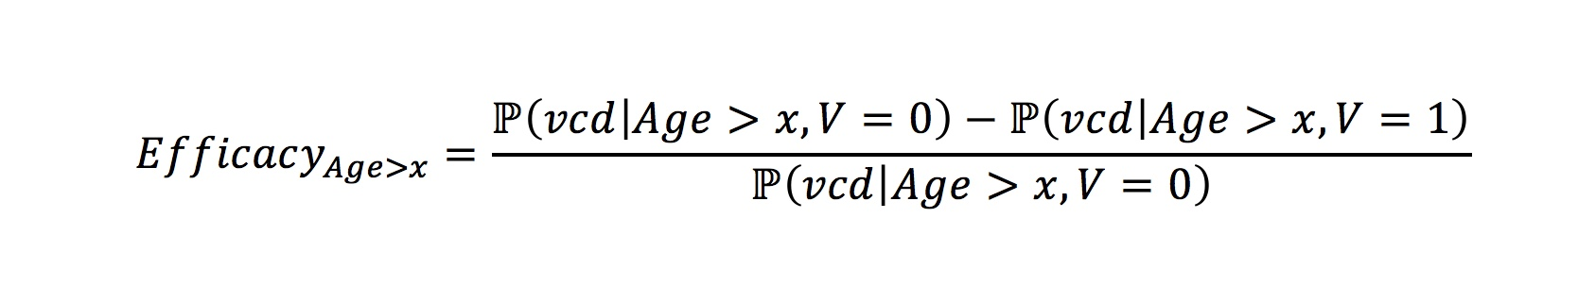
The distribution of efficacy in Age subgroups
P represents probabilities from REFS™ ensemble
V represents vaccination status
Notes:
Include a simple 1-sentence statement of what information this equation gives us. i.e “A ration of likelihood that a vaccinated child will not get VCD.”
They won’t take this as speaking down to them, they will take it as us proving that we know how they use the term ‘efficacy’ and are working from the same definition.

Slide 14
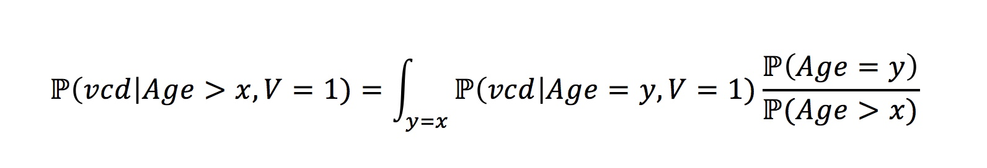
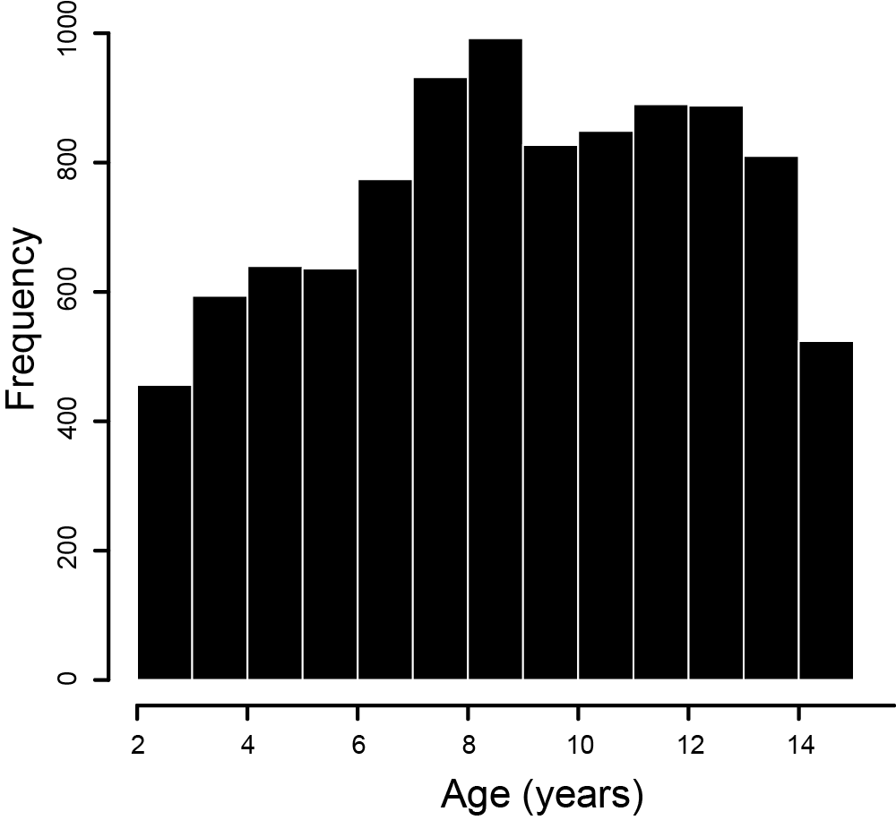
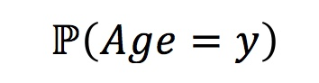
Efficacy marginals are computed from Age distribution
Age distribution for CYD14
Notes:
Efficacy Marginials are Computed from the Age Distribution

Slide 15
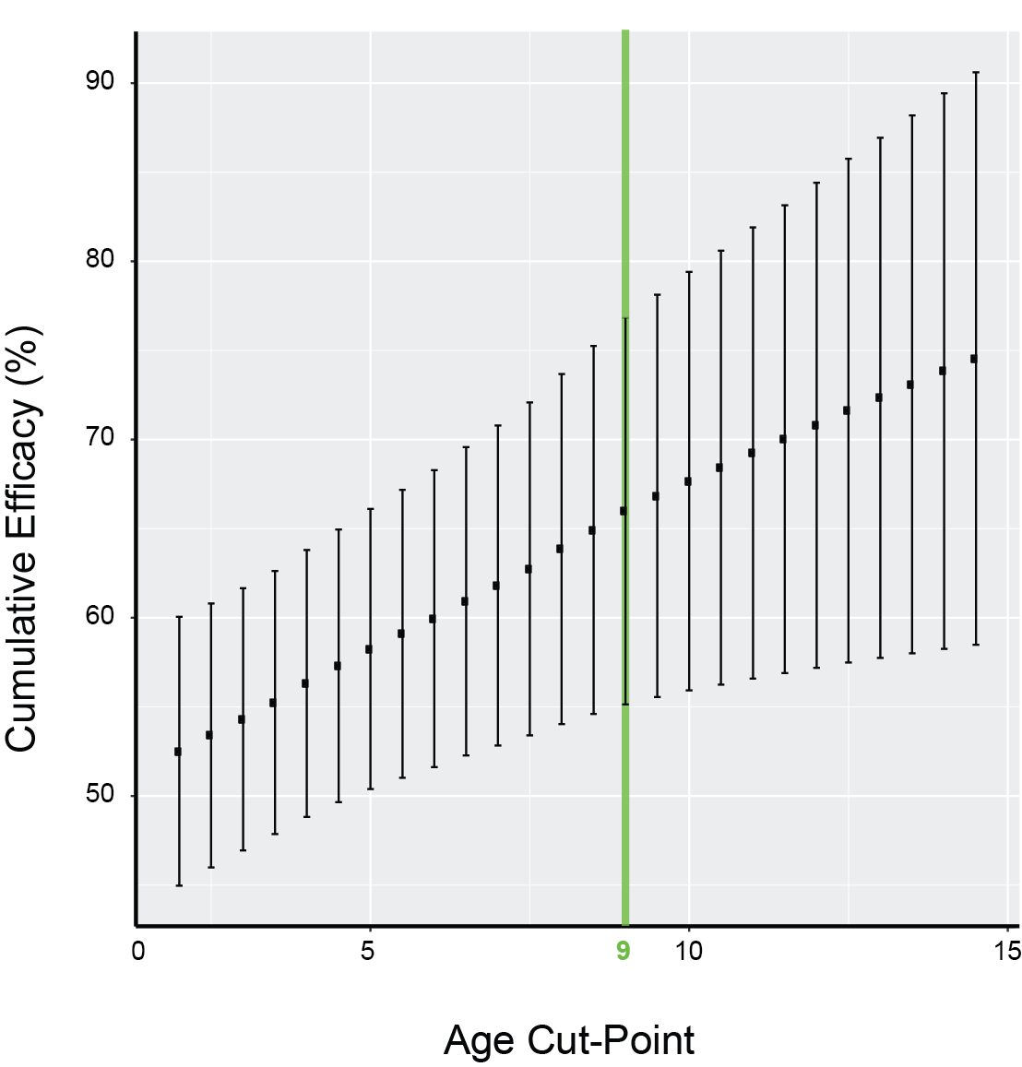
CYD14 model predicts vaccine efficacy of older age-groups
Simulated vaccine efficacy allows the theoretical evaluation of different Cut-Points.
Vaccine Efficacy is cumulative from the age cut point to 14.
Age Cut-Point = 9 maps to the efficacy of the subpopulation 9-14 years old.
REFS™ Simulation Result

Slide 16
CYD14 model predicts vaccine efficacy of CYD15
Study Population | CYD 14 (2-14 years) | CYD15 (9-16 years) | REFSTM Prediction
2-14 years | 54.8% (46.8 - 61.7) |  | 53% (46%-60%)
9 - 16 years |  | 64.7% (58.7 – 69.8) | 66% (55-77)
12 – 16 years | 74.4% (59.2 – 84.3) | 67.6% (59.3 – 74.3) | 71% (57%-84%)
Peter Smith
London School of Hygiene & Tropical Medicine
(for Stephen Thomas)
B. Guy et al/ Vaccine 33 (2015) 7100-7111

Slide 17
Conclusions
There is a confounding relationship between Baseline PRNT, Age, and VCD
Age drives differential response to the vaccine
Inferring efficacy of subgroups is accurate when controlling for confounding effects
Proposal for follow up analysis:
Research the confounding relationship between Baseline PRNT, Age, and VCD
Research the effect of Age on Hospitalization Incidence
Research the effect of Baseline PRNT on Hospitalization Incidence while controlling for the confounding effect of Age.

Slide 18
Contact Us
Headquarters
Research and Management
Dan Cunha dcunha@gnshealthcare.com
Birgit Schoeberl bschoebe@gnshealthcare.com
Cecilia Washburn
cwashburn@gnshealthcare.com
Massachusetts Office
196 Broadway Cambridge, MA 02139

Slide 19
Appendix

Slide 20
Data frame
Baseline variables
Demographics (SDTM Domain: Demographics)
Age
Country
Medical history (SDTM Domain: Medical History)
Dengue infection history
Japanese encephalitis vaccine historyGoogle trends
Weather
Outcome variables
VCD at anytime during active phase (derived from SDTM Domain: LAB TESTS)
Hospitalizations during active phase and entire trial duration (SDTM Domain: Clinical Events)
Occurrence
Total number of hospitalizations
Total number of days

Slide 21
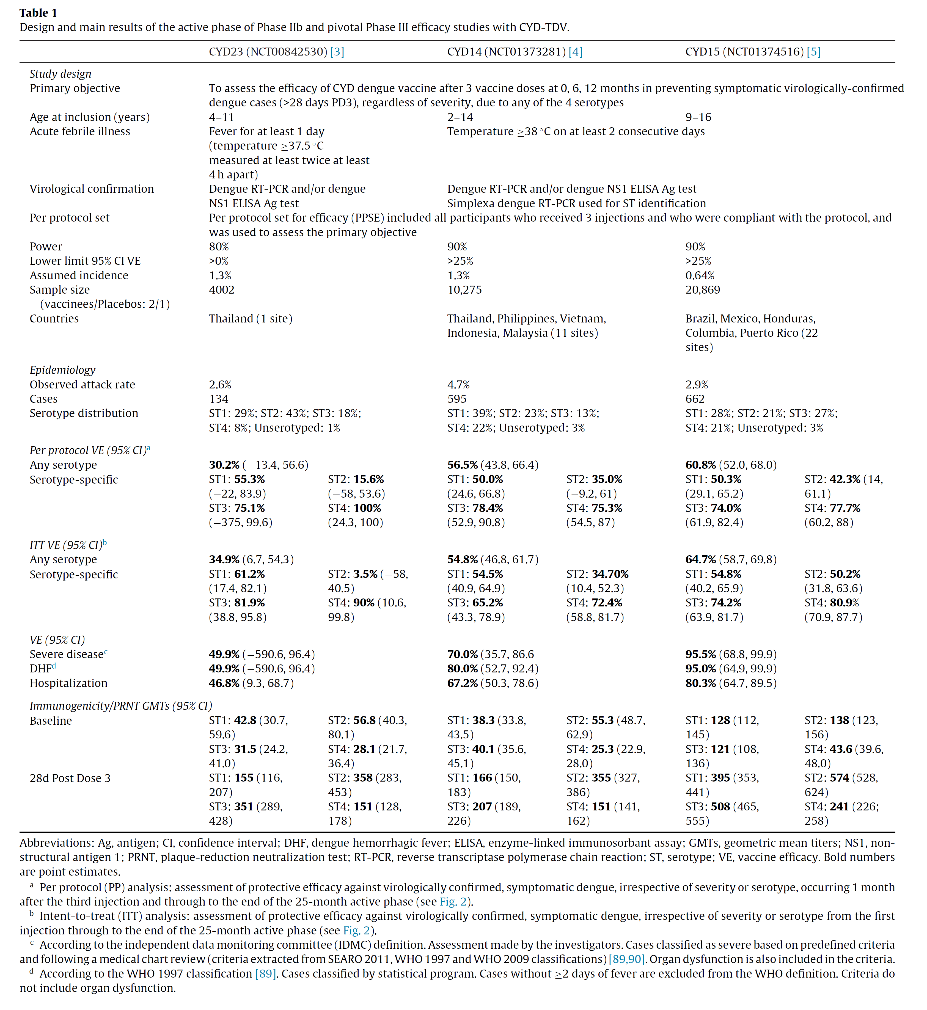
Summary of the design and results of clinical studies

Slide 22
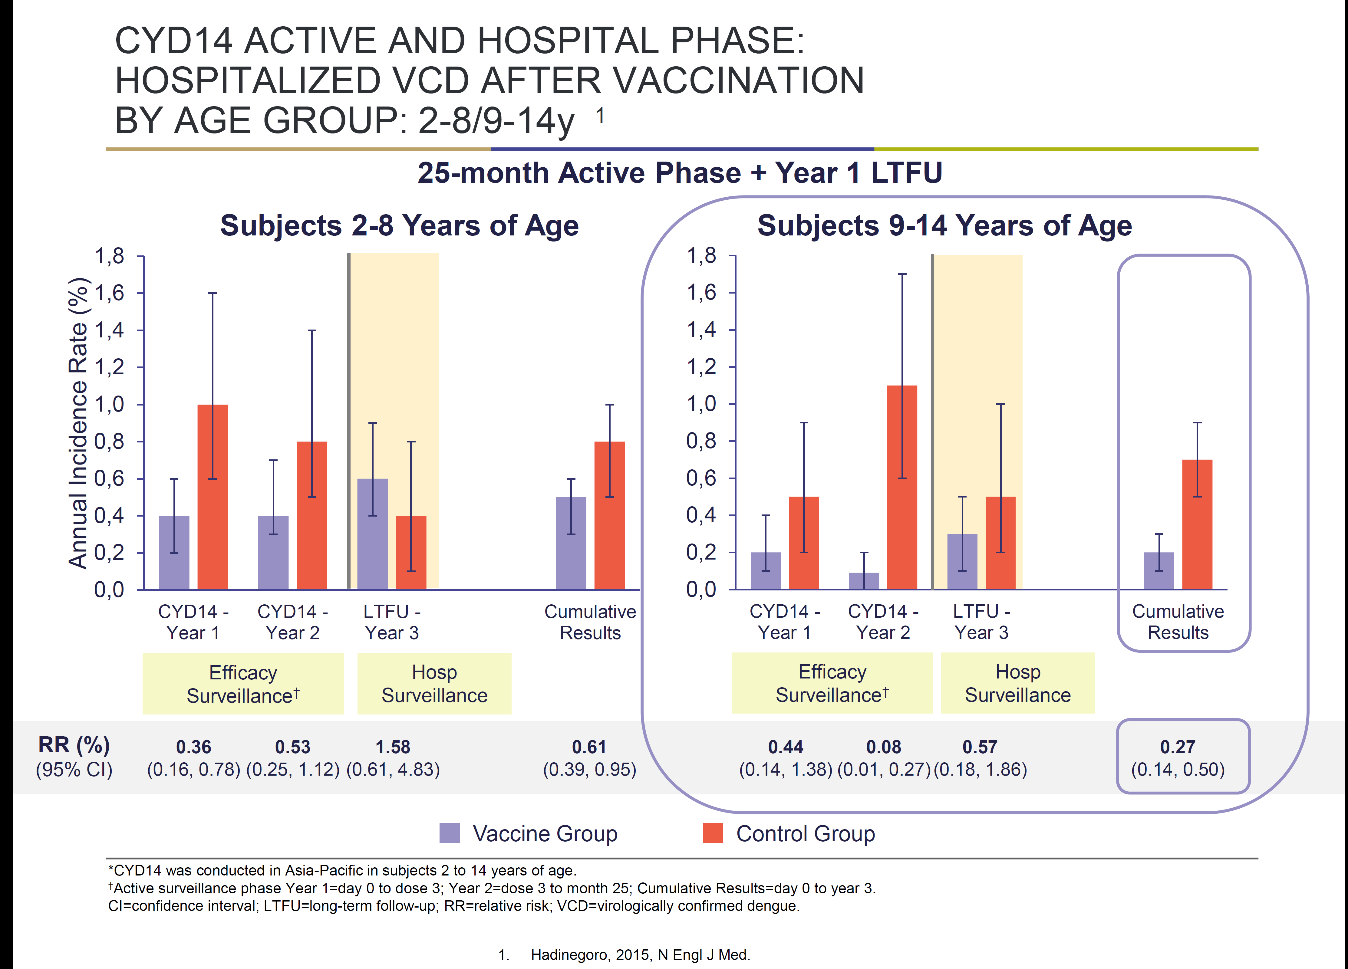
Incidence rate of hospitalization is lower in age group 9-14
Notes:
Again, make clear when we are showing their own findings

Slide 23
Odds Ratio equation

